Slide 1
Effect of competition on a threatened species
Centaurea Corymbosa D. Groffman, I. Moodie, B. Shahid

Slide 2
Study species
Centaurea corymbosa is an endemic plant species of La Clape, an region in Southern France.
It is closely related to other Centaurea species found in the region, but unlike C. corymbosa, these are very abundant.

Slide 3
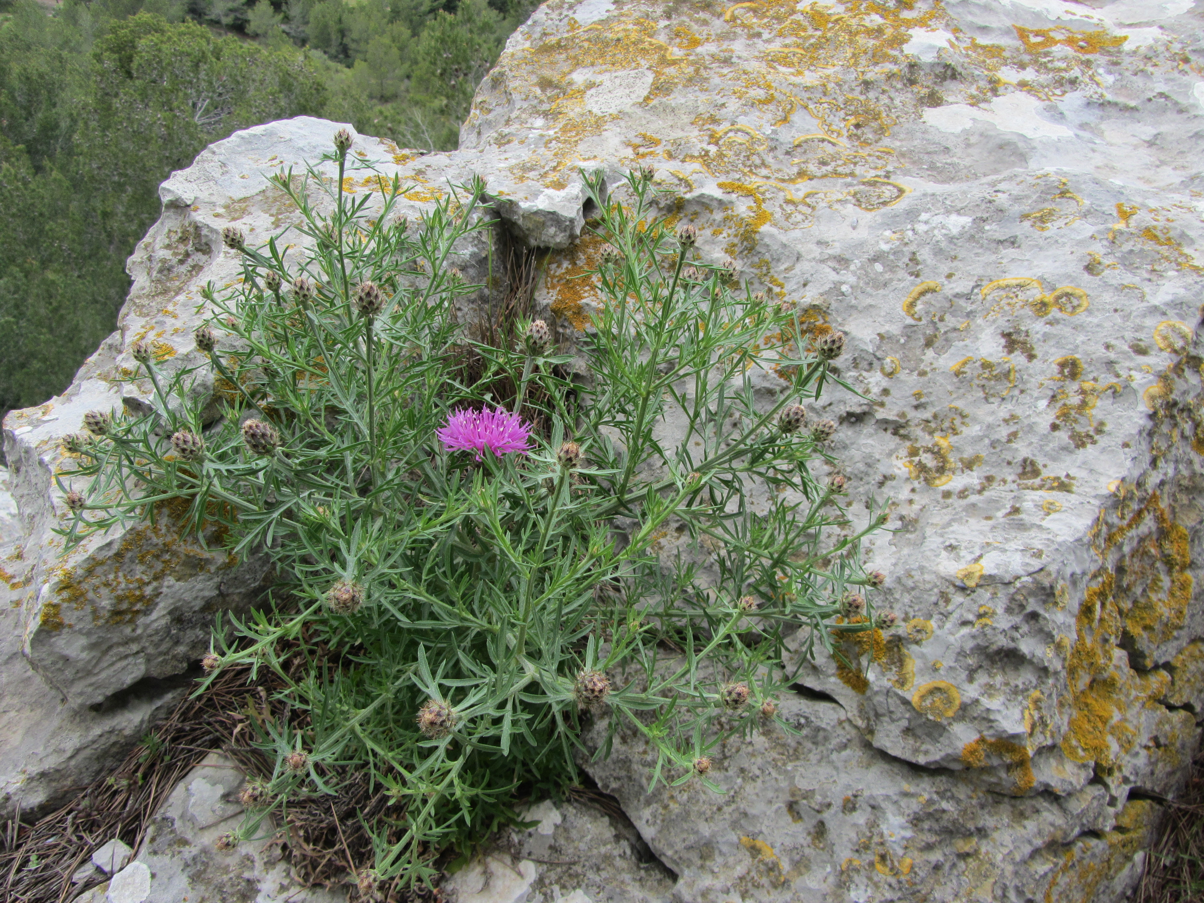
C. corymbosa

Slide 4
Our question
Is Centaurea corymbosa threatened because it is not as competitive as other Centaurea species?

Slide 5
The experiment (1/2)
Seeds of two Centaurea species were collected from four populations, two with only C. corymbosa present and two with only C. maculosa present.
Seeds were sown one per pot.
Competition was induced by growing Brachypodium ramosum in the pots, but at different densities:
Control: no B. ramosum
Not dense: B. ramosum covers 10% of the surface area of the pot
Dense: B. ramosum covers between 10 and 50% of the surface area of the pot
Very dense: B. ramosum covers more than 50% of the surface area of the pot

Slide 6
The experiment (2/2)
For each treatment, 50 replicates were seeded for each population and each species, for a total of 800 seeds monitored at different time intervals: each week for 3 weeks, and then once per month*.

Slide 7
 | C.c. (Pop1) | C.c. (Pop2) | C.m. (Pop3) | C.m. (Pop4)
Control | C.c. (Pop1)/Control | C.c. (Pop2)/Control | C.m. (Pop3)/Control | C.m. (Pop4)/Control
Not Dense | C.c. (Pop1)/Not Dense | C.c. (Pop2)/Not Dense | C.m. (Pop3)/Not Dense | C.m. (Pop4)/Not Dense
Dense | C.c. (Pop1)/Dense | C.c. (Pop2)/Dense | C.m. (Pop3)/Dense | C.m. (Pop4)/Dense
Very Dense | C.c. (Pop1)/Very Dense | C.c. (Pop2)/Very Dense | C.m. (Pop3)/Very Dense | C.m. (Pop4)/Very Dense

Slide 8
The dataset (1/2)
Plante: number of the seed/plant (1 to 800)
Espece: species (mac, C. maculosa, cor, C. corymbosa)
Pop: population names
Traitement: treatment factor
PAR: quantity of light received by a pot, which depends on the percentage of soil covers ; it is 100% in control pots
Reference: quantity of light received by a pot where it is not covered. it is 100% in control pots

Slide 9
The dataset (2/2)
Date_de_germination: germination date; missing data if the seed did not germinate
Cotyledons: size of the emerged seedling
Taille_Dec_05: size of the rosette in December 2005
Taille_Fev_06: size of the rosette in Feburary 2006
Taille_Mars_06: size of the rosette in March 2006
Taille_Juin_06: size of the rosette in June 2006
Taille_Sept_06: size of the rosette in September 2006

Slide 10
Data cleaning (1/n)
# Format the date of germination correctly data$Date_de_germination <- as.Date(data$Date_de_germination, format = "%d/%m/%Y") head(data[1:3,1:5])
## # A tibble: 3 x 5 ## Plante Date_de_germina~ Cotyledons Taille_Dec_05 ## <dbl> <date> <dbl> <dbl> ## 1 1 NA NA 0 ## 2 2 NA NA 0 ## 3 3 NA NA 0 ## # ... with 1 more variable: Taille_Fev_06 <dbl>
1st decision - We are not interested in the rosette size of plants that do not germinate, so set to NA

Slide 11
Data cleaning (2/n)
# If plant didn't germinate, it should not have a rosette size data_nogerm <- data %>% filter(is.na(Date_de_germination)) %>% mutate(Taille_Dec_05 = NA, Taille_Fev_06 = NA, Taille_Mars_06 = NA, Taille_Juin_06 = NA, Taille_Sept_06 = NA) data_germ <- data %>% filter(!is.na(Date_de_germination)) fulldata <- full_join(data_nogerm, data_germ)
## Joining, by = c("Plante", "Date_de_germination", "Cotyledons", "Taille_Dec_05", "Taille_Fev_06", "Taille_Mars_06", "Taille_Juin_06", "Taille_Sept_06", "traitement", "PAR", "reference", "espece", "pop")

Slide 12
Data cleaning (3/n)
2nd decision: We are interested in the size of the rosette over time, as this will be our indication of how well each plant is coping with the competition.
gathered_data <- fulldata %>% rename("2005-12-01" = "Taille_Dec_05", "2006-02-01" = "Taille_Fev_06", "2006-03-01" = "Taille_Mars_06", "2006-06-01" = "Taille_Juin_06", "2006-09-01" = "Taille_Sept_06") %>% gather(key = "Date", value = "Rosette_size", "2005-12-01":"2006-09-01") gathered_data$Date <- as.Date(gathered_data$Date, format = "%Y-%m-%d")

Slide 13
Data cleaning (4/n)
3rd decision: To make sense of the light data, we divide the PAR received by the plant through the Brachypodium by the max PAR that pot was receiving (actual/max possible). As the max values were taken for areas within the greenhouse (presumed), not each pot, some values of actual/max are slightly above 1.
gathered_data <- gathered_data %>% mutate(light = PAR/reference)

Slide 14
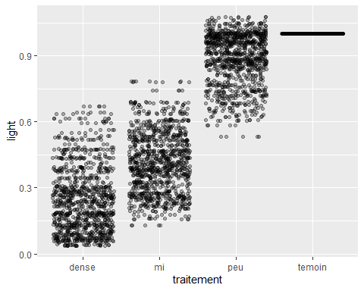
Data exploration (1/n)

Slide 15
Is light received (actual PAR / Max PAR) perhaps a better measure of competition than the visual sorting of % soil covered?

Slide 16
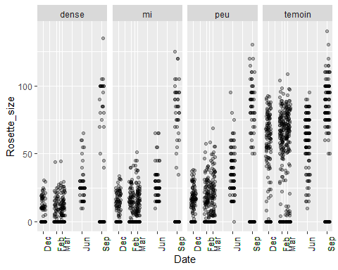
Data exploration (2/n)

Slide 17
Something is weird: lack of 0s in the June measurements

Slide 18
Data exploration (3/n)
No zeros in June? - Does this make sense? - Is this an issue?

Slide 19
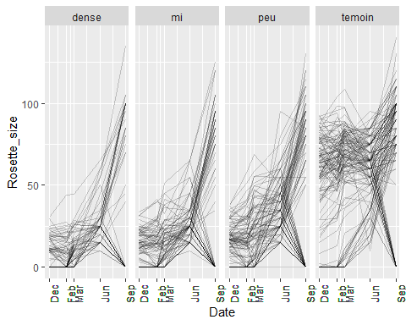

Slide 20
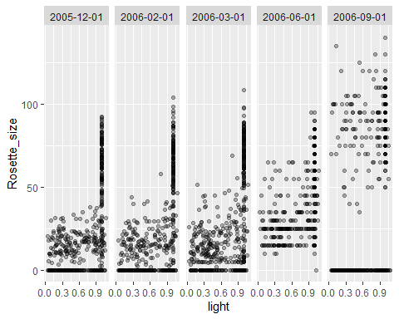
TEST

